Slide 1

Smart Home System
Prepared By:
Tasawar Siddiquy Asm Nurussafa

Slide 2
Topics to discuss:
Introduction to Smart Homes: Pros and Cons.
Ideas and scenario explanations using Activity and Sequence diagrams.
Smart Window scenario implementation- C++ implementation and μC implementation.
Smart Lighting System implementation- C++ implementation and μC implementation.

Slide 3
Ideas & Scenarios

Slide 4
Smart Gardening:
A separate space for garden in the house for the plant lovers. The smart home will allow devices like GreenSens to be compatible with it, keeping the user constantly updated about the health of each of the plants in the garden.
Requirements: GreenSens, Space in the house.

Slide 5
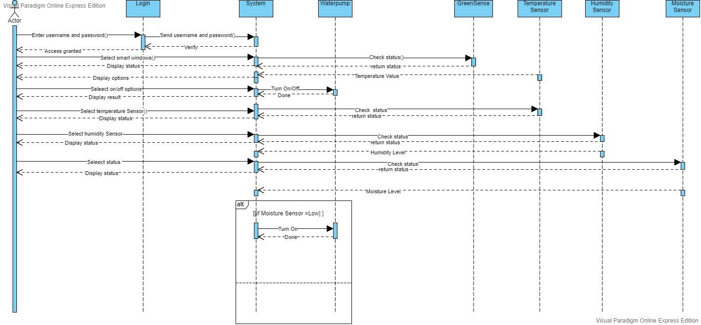
Sequence Diagram

Slide 6
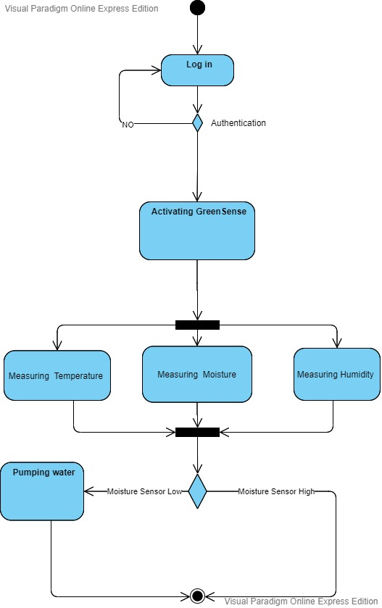
Activity Diagram

Slide 7
Gas Leakage:
Generally in our region, we are highly dependent on gas-controlled stoves. This is, indeed, very dangerous. To make a safer environment in the house, our smart home will include a gas leakage system. This system will generally keep track of gas level in the kitchen vicinity. Once the gas level in the kitchen is more than usual, or out of control, the system will take precautionary measures, such as an alarm system will go off, shutting off the gas flow and on user preference, the windows might open.
Requirements: Gas sensor, alarm system, Micro-controller.

Slide 8
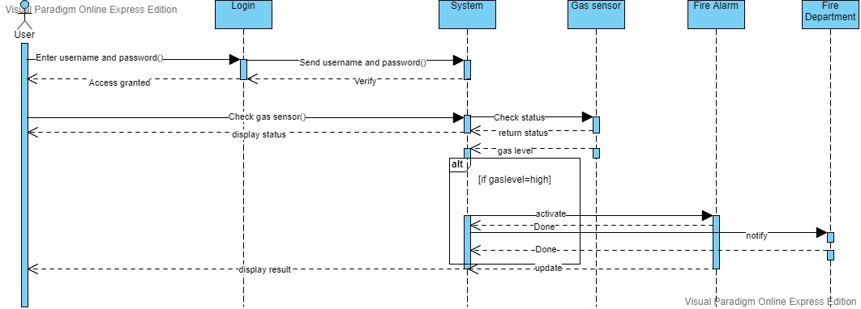
Sequence Diagram

Slide 9
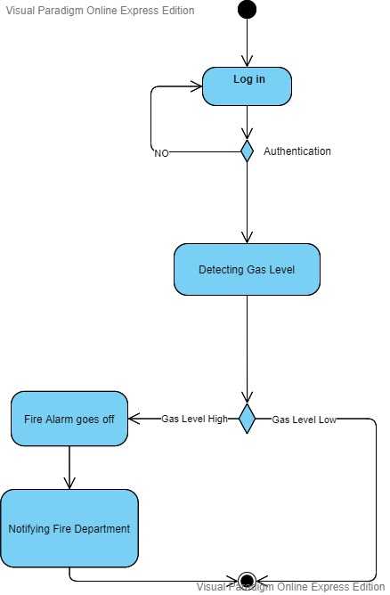
Activity Diagram

Slide 10
Rain water-recycling system:
Luckily, our region has rainy seasons. While this is a real problem, but can also be used to our benefits. Our smart home can store the excess rain water by strategical planning throughout the house, and recycle them; e.g. by purifiying the water or use them in the smart gardening system.
Requirements: Water reservoirs, filter system, water-pumps.

Slide 11
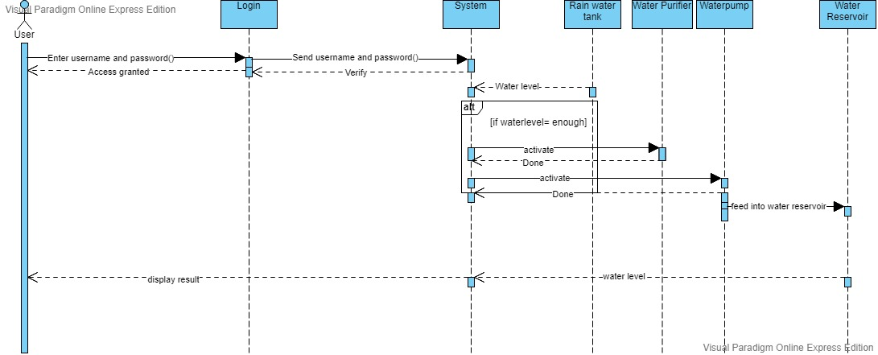
Sequence Diagram

Slide 12
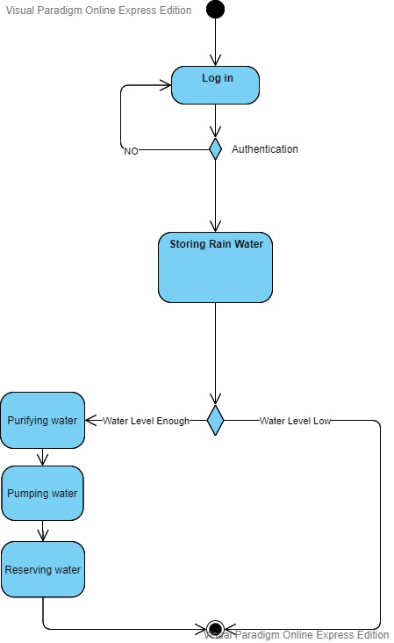
Activity Diagram

Slide 13
Insect Repellers:
Our region is also very prone to insects, especially mosquitoes. Our smart home will include a central system to kill insects, or drive them away. This can be controlled by activating some insect-repelling devices and closing the windows at specific times of a day to keep the insects at bay.
Requirements: Ultrasonic pest repellent.

Slide 14
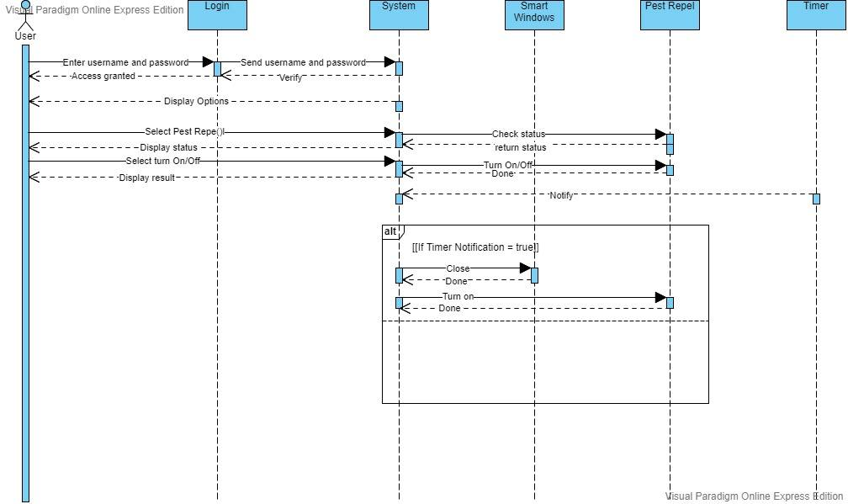
Sequence Diagram

Slide 15
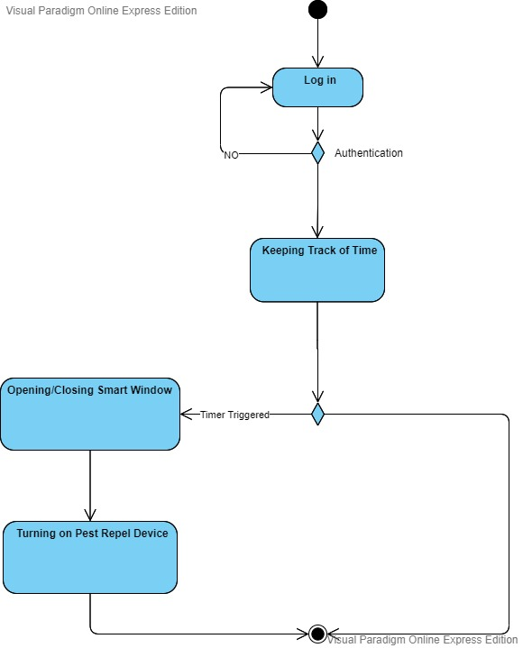
Activity Diagram

Slide 16
Lightning Rods:
Lightnings are a common phenomenon in our region. In fact, very few houses have precautions to this. So as a precaution, we can use lightning rods to direct the lightning to the ground. So, the smart system can activate the lightning rod, when it can foresee thunderstorms. Requirements: Smart ESE lightning rod (ESE28)

Slide 17
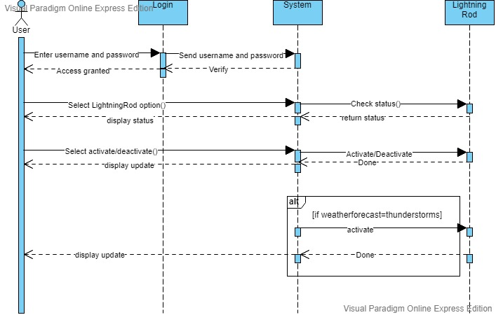
Sequence Diagram

Slide 18
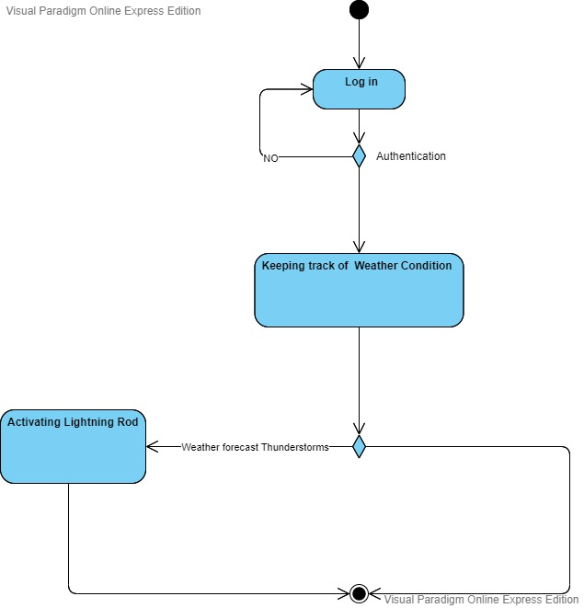
Activity Diagram

Slide 19
Class Diagram For Smart Home System

Slide 20
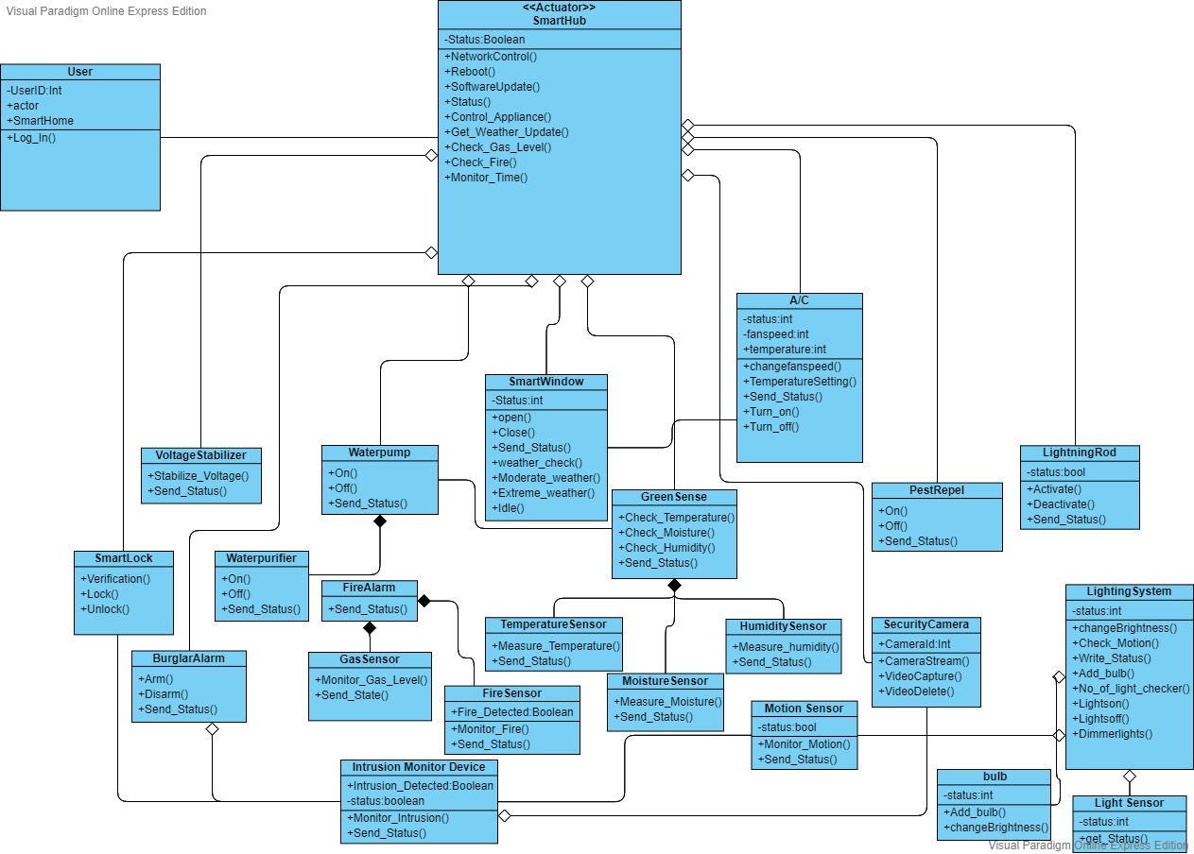

Slide 21
Use-Case Diagram For Smart Home System

Slide 22
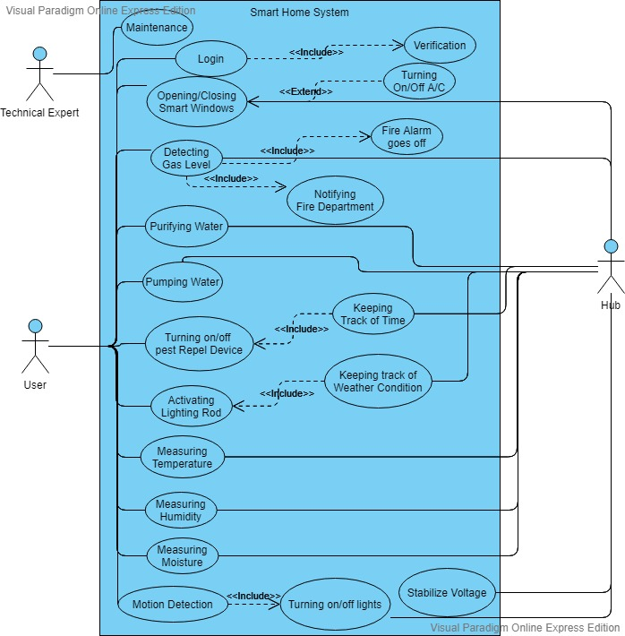

Slide 23
Smart Windows:
Smart windows will be automatically closed in case of extreme weather or rain. This is can be user-preference based, the user can set a temperature; depending on which the AC or heater will be automatically activated/ deactivated.
Requirements : Windows, Micro-controller, AC, Wifi.

Slide 24
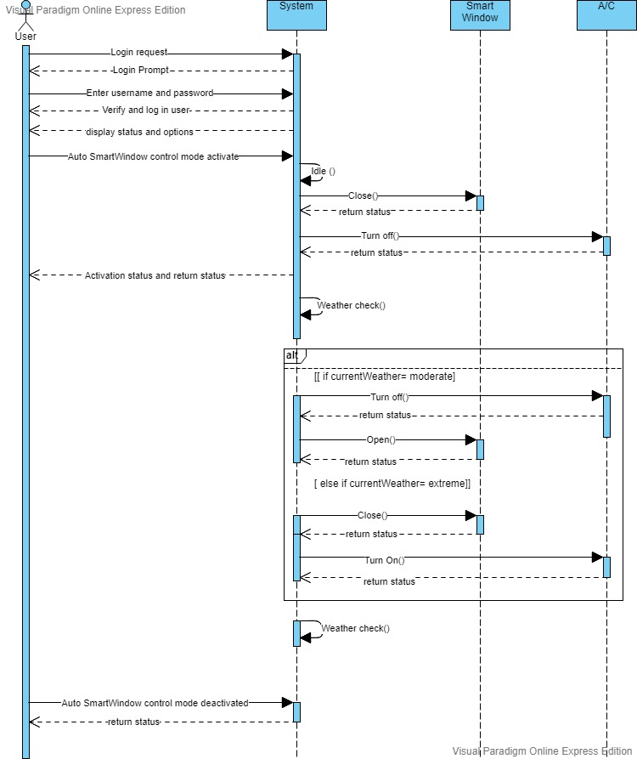
Sequence Diagram

Slide 25
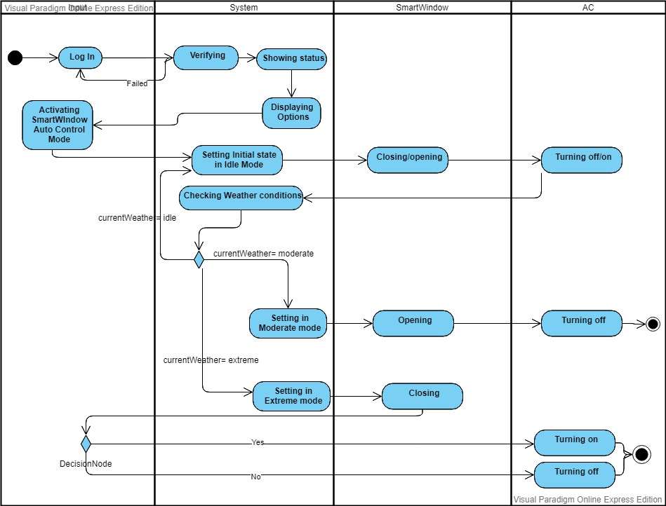
Activity Diagram

Slide 26
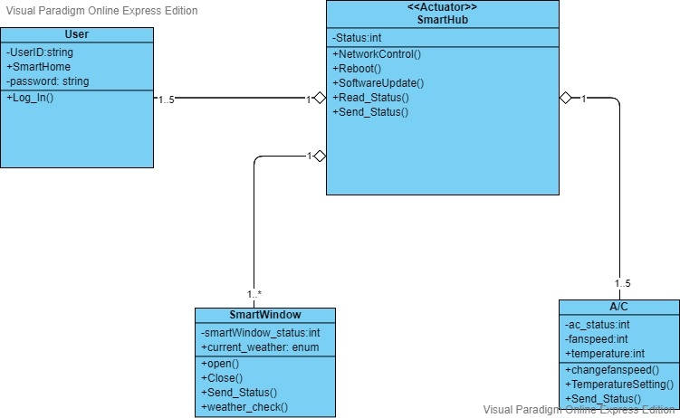
Class Diagram

Slide 27
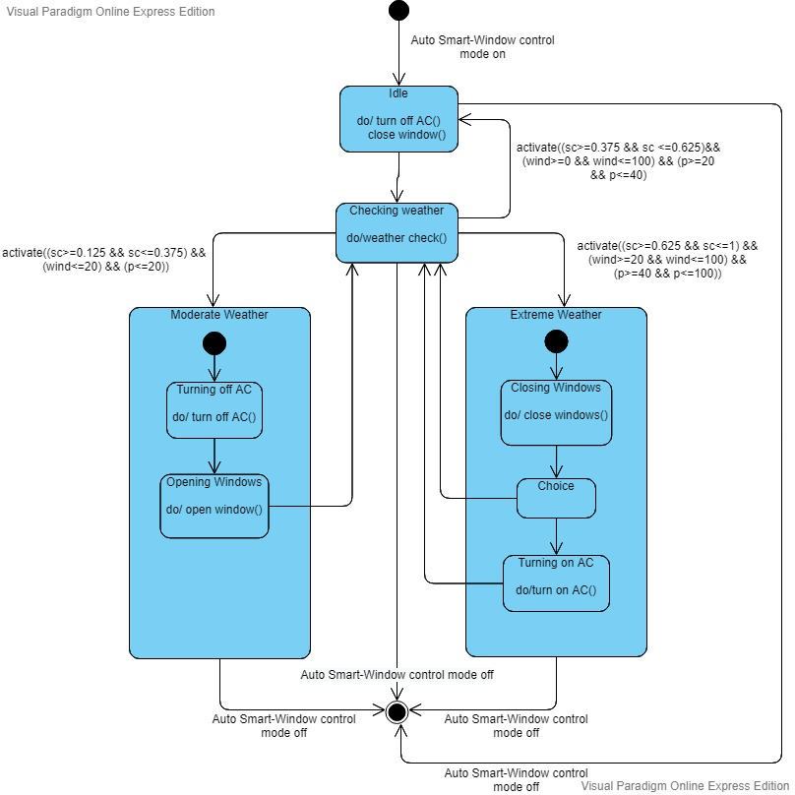
State-Machine Diagram

Slide 28
Thank you!

